Slide 1
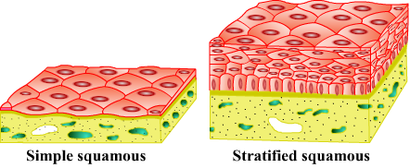
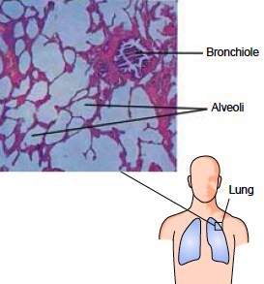
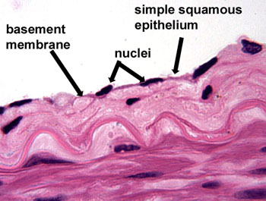
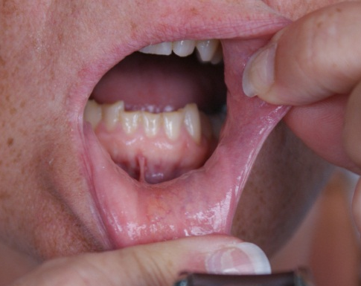
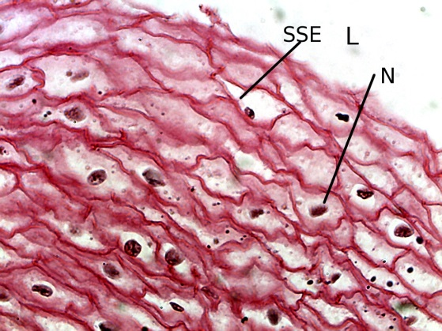
Types of Epithelial Tissues
Simple squamous epithelium
Cells are extremely thin, flat, and form a delicate lining.
Present in : Lining of blood vessels, lungs alveoli, oesophagus, lining of mouth.
Function : Transportation of substances through selectively permeable membrane.
Tiny air sacs
Food pipe
Plasma membrane
Oesophagus
Lining of mouth
Lining of blood vessels
Lungs alveoli

Slide 2
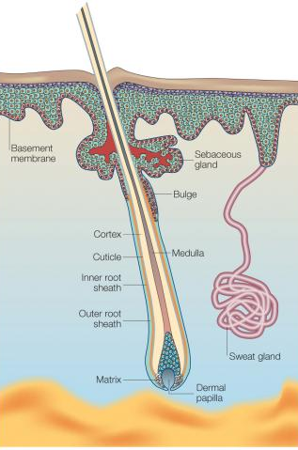
Types of Epithelial Tissues
Stratified squamous epithelium
In this tissue, the cells are arranged to form a pattern of layers.
Present in : Outer layer of skin.
Function : Protects the body organs, prevents wear and tear of skin.
Damage

Slide 3
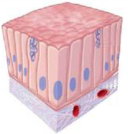
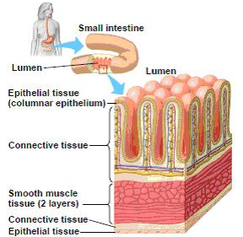
Types of Epithelial Tissues
Columnar epithelium
These cells are tall and arranged like pillars.
Present in : Inner lining of intestine.
Function : Secrete digestive enzymes and performs absorption of nutrients from digested food.

Slide 4
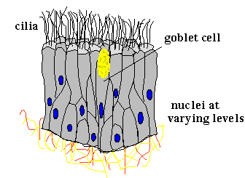
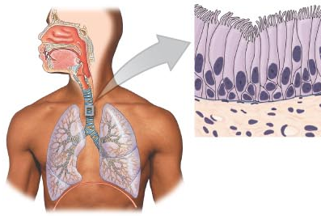
Types of Epithelial Tissues
Ciliated columnar epithelium
Columnar epithelium having hair like projections.
Present in : Respiratory tract.
Function : Due to movement of the cilia, the mucous and air is pushed forward to clean the respiratory tract.

Slide 5
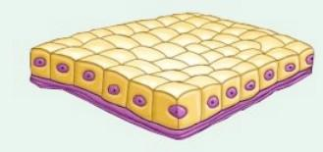
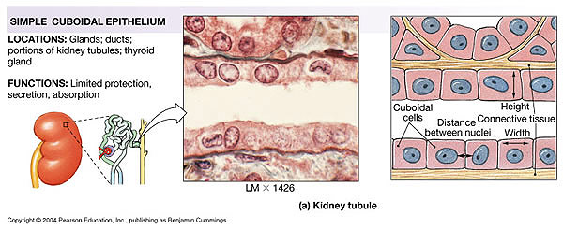
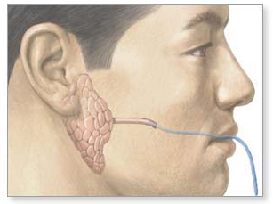
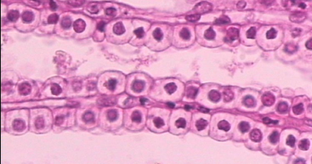
Types of Epithelial Tissues
Cuboidal epithelium
The cells are cube shaped.
Present in : Lining of kidney tubules and ducts of salivary glands.
Function : It helps in the absorption of useful materials, from urine before it is passed out and also helps in the secretion of saliva.
Tiny tubes which produce urine
Tubes which carry saliva

Slide 6
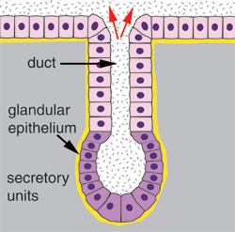
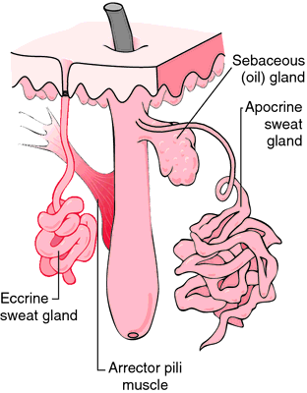
Types of Epithelial Tissues
Glandular epithelium
Sometimes a portion of the epithelial tissue folds inward to form a multicellular gland.
This structure is called glandular epithelium.
Function : It performs the function of secreting substances like, sweat, oil, mucous from the skin.

